Slide 1

“Code Troopers” Geopop Browser
April 24th, 2022

Slide 2

Introduction
Mission of Kamino Softworks
Kamino Softworks as a team
Aims of Geopop

Slide 3

Technologies and Methods
Kanban and Agile Methodology
Github and continuous integration
Docker and modular deployment

Slide 4

Geopop Tutorial and Demo
Functionality Demonstration
Example searches and scenarios
Please ask specific functionality questions now!

Slide 5

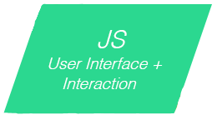

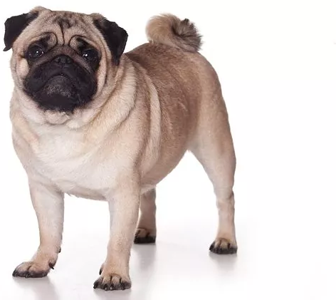
PUG and CSS (Front-End)
CSS style describing all formatting
.pug files to display all web pages and create user interactions
Dynamic content pulled on country search page

Slide 6

Node.js
Connection between all program elements
Input into query conversions with a variety of options already
Framework for further functionality and implementations

Slide 7

Introducing the Database
SQL done in PHPMyAdmin
Full integration and query done through Node JS
Linked to the Front end in country.js

Slide 8

Viability
Common persons use of software
Specialist use of software
Database Updatability and longevity

Slide 9
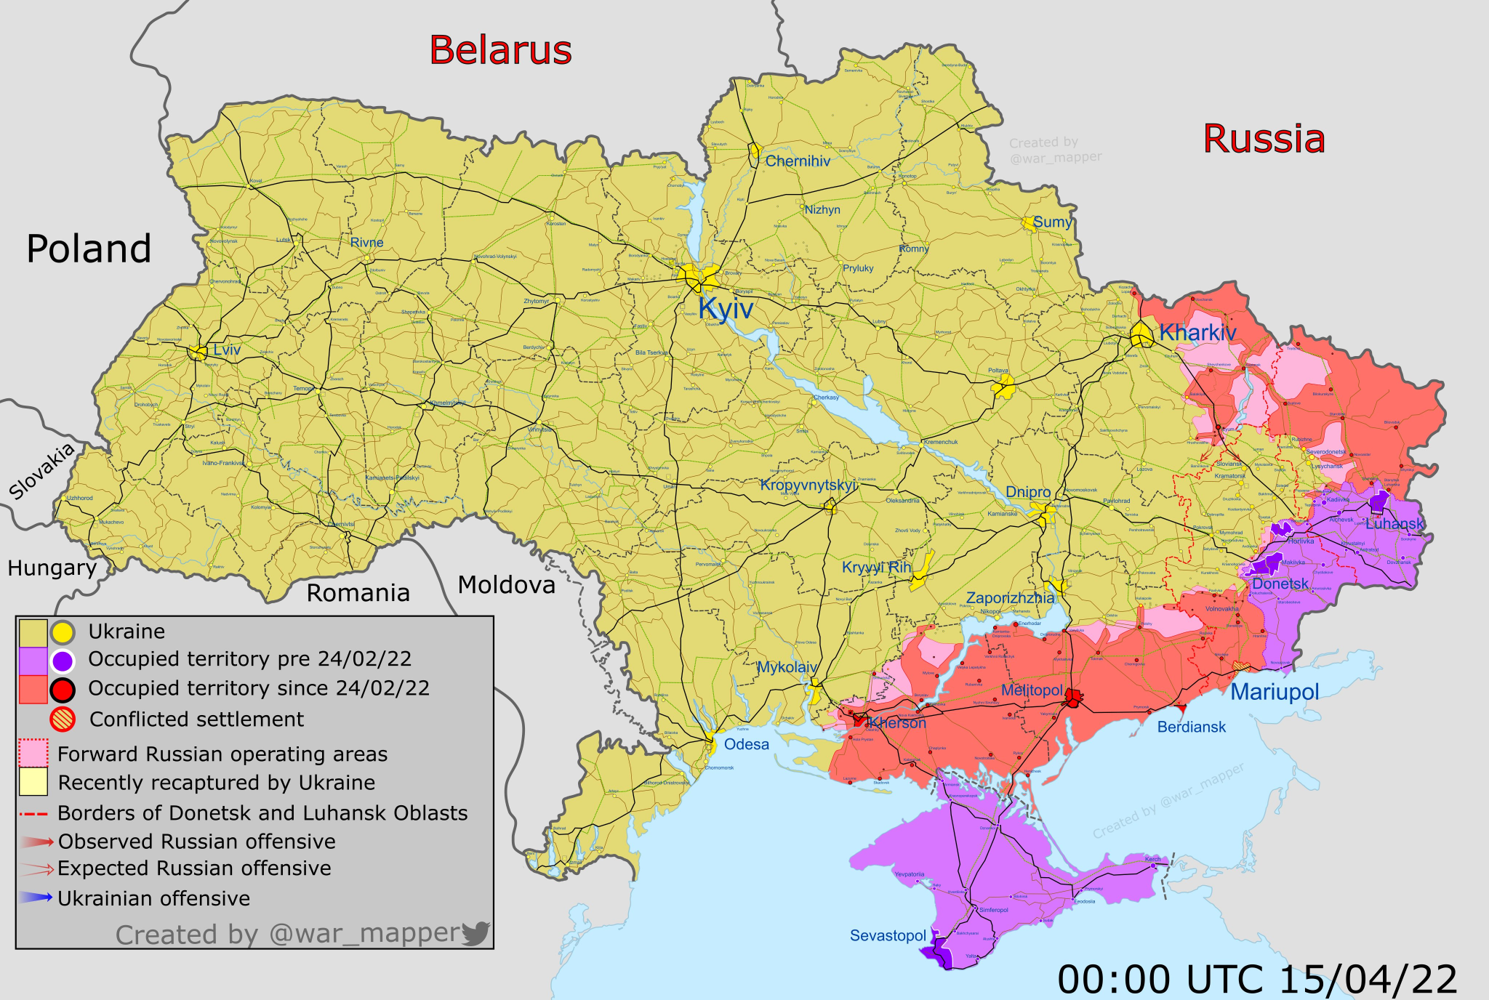
Difficulties and acknowledgements
Every 5th sale goes to support Ukraines fight for freedom.
Non-Political Stance
Fair treatment and pay

Slide 10

Conclusion
Mission statement revisited
Geopop MARS
Queries not for Database?

Slide 11


Slides prepared by Code Troopers
Add your
Software Engineers at Kamino Softworks who work to change the world and improve the lives of people around the globe. Graduates from Roehampton in 2023 with a degrees in Computer Science. Love to work improving the future with a diverse and dedicated staff.
Code Troopers make no claim to ownership of Media images in this powerpoint. Images taken from Google.

